Slide 1
PREPOSITIONS
By- Vidisha Kashyap

Slide 2
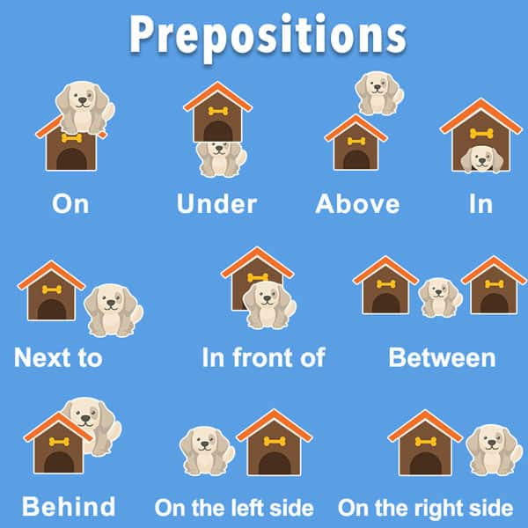
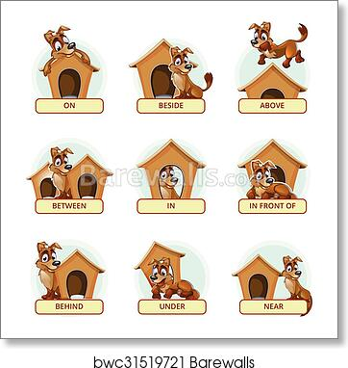

Slide 3
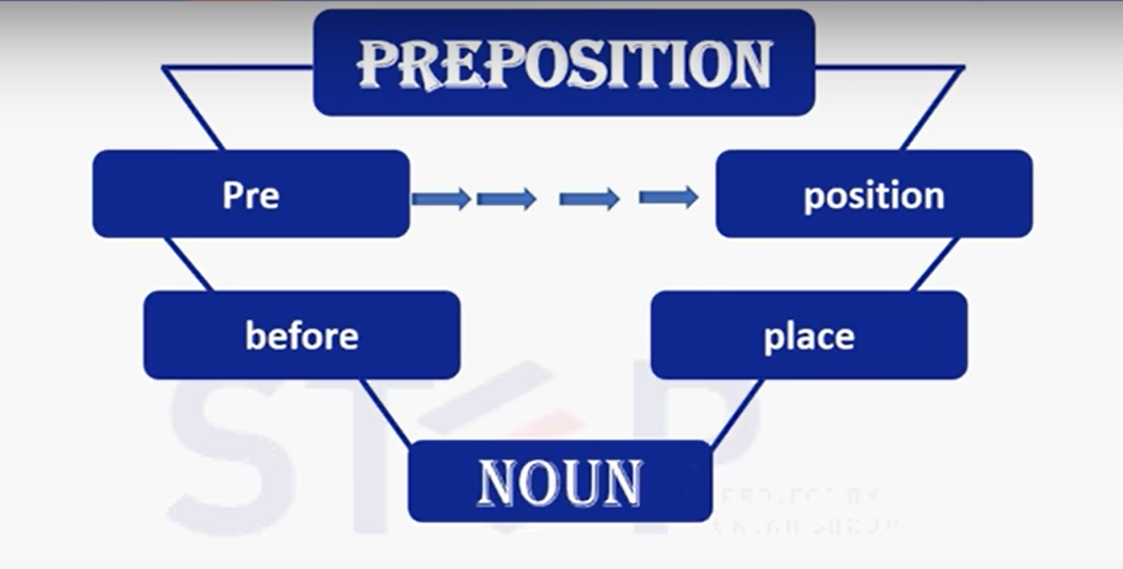

Slide 4
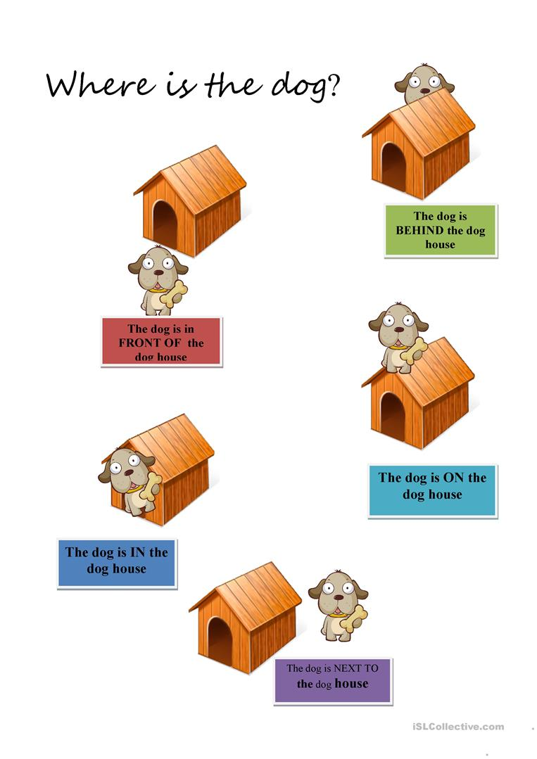

Slide 5
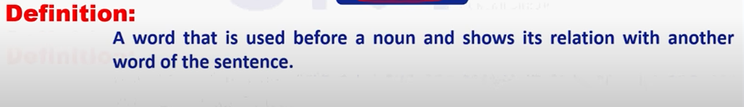
Some examples of prepositions are words like "in," "at," "on," "of," and "to."
e.g: He goes to college by bus.
PREPOSITION or ADVERB
He goes into the office.
He goes in.

Slide 6
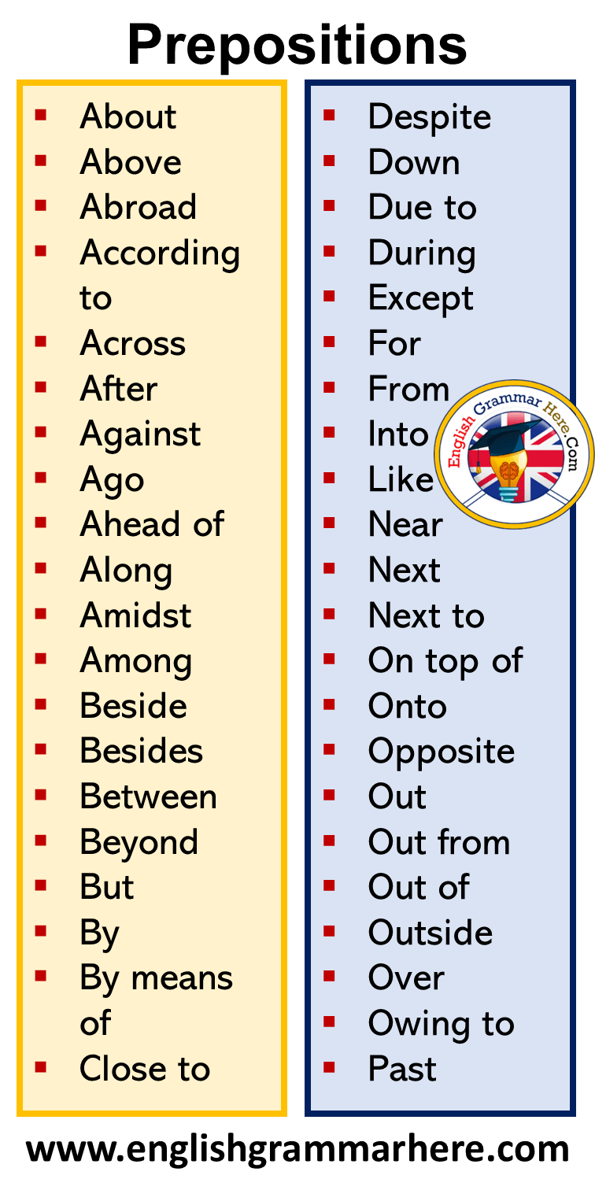

Slide 7
Few Rules
Prepositions of Direction
To refer to a direction, use the prepositions "to," "in," "into," "on," and "onto."
She drove to the store.
Don’t ring the doorbell. Come right in(to) the house.
Drive on(to) the grass and park the car there.

Slide 8
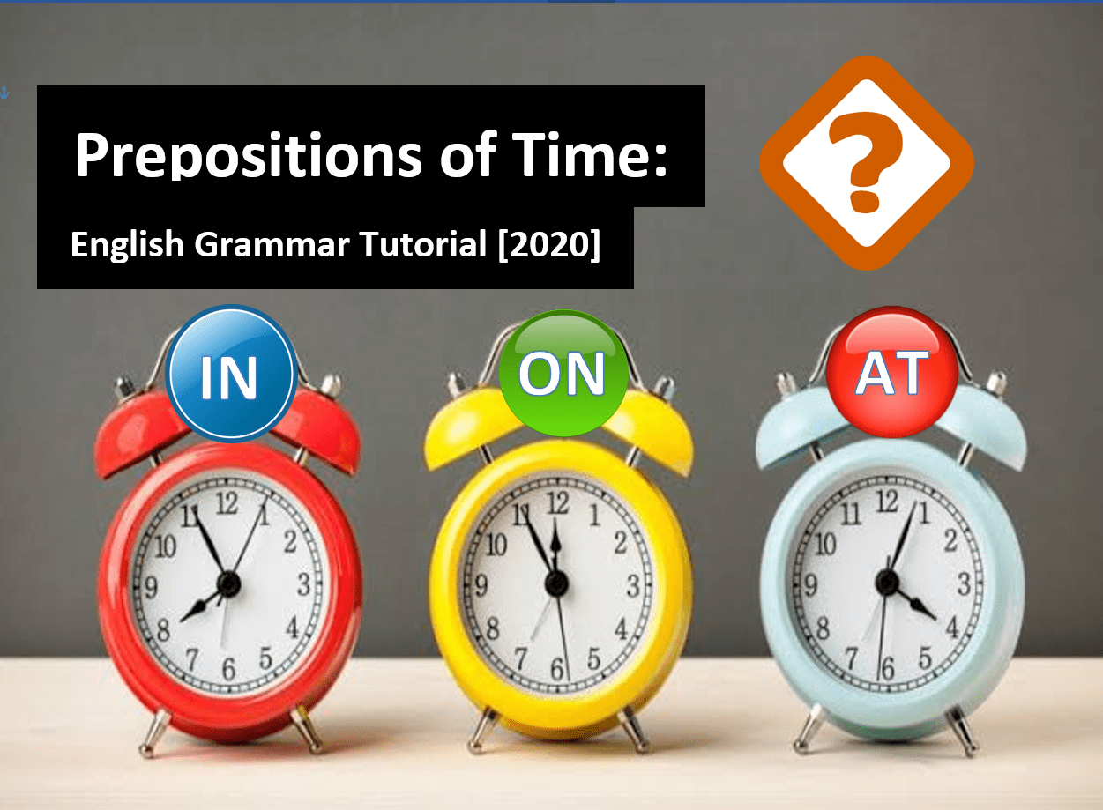
Prepositions of Time
To refer to one point in time, use the prepositions "in," "at," and "on."
Use "in" with parts of the day (not specific times), months, years, and seasons.
He reads in the evening.
The weather is cold in December.
She was born in 1996.
We rake leaves in the fall.
Use "at" with the time of day. Also use "at" with noon, night, and midnight.
I go to work at 8:00.
He eats lunch at noon.
She often goes for a walk at night.
They go to bed at midnight.

Slide 9
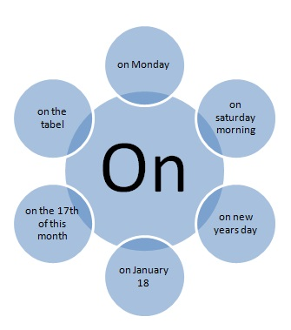
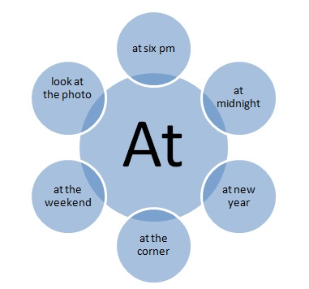

Slide 10
Use "on" with days.
I work on Saturdays.
He does laundry on Wednesdays.
To refer to extended time, use the prepositions "since," "for," "by," "during," "from…to," "from…until," "with," and "within."
I have lived in Minneapolis since 2005. (I moved there in 2005 and still live there.)
He will be in Toronto for 3 weeks. (He will spend 3 weeks in Toronto.)
She will finish her homework by 6:00. (She will finish her homework sometime between now and 6:00.)
He works part time during the summer. (For the period of time throughout the summer.)
I will collect data from January to June. (Starting in January and ending in June.)
They are in school from August until May. (Starting in August and ending in May.)
She will graduate within 2 years. (Not longer than 2 years.)

Slide 11
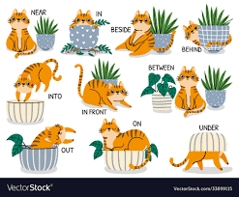
PREPOSITIONS OF PLACE

Slide 12
Prepositions of Place
To refer to a place, use the prepositions "in", "at", "on", and "inside".
They will meet in the lunchroom.
She was waiting at the corner.
He left his phone on the bed.
Place the pen inside the drawer.
To refer to an object higher than a point, use the prepositions "over" and "above." To refer to an object lower than a point, use the prepositions "below," "beneath," "under," and "underneath."
The bird flew over the house.
The plates were on the shelf above the cups.
Basements are dug below ground.
There is hard wood beneath the carpet.
The squirrel hid the nuts under a pile of leaves.
The cat is hiding underneath the box.

Slide 13

To refer to an object close to a point, use the prepositions "by," "near," "next to," "between," "among," and "opposite."
The gas station is by the grocery store.
The park is near her house.
Park your bike next to the garage.
There is a deer between the two trees.
There is a purple flower among the weeds.
The garage is opposite the house.
Prepositions of Location
To refer to a location, use the prepositions "in", "at", and "on".
They live in the country. (an area)
She will find him at the library. (a point)
There is a lot of dirt on the window. (a surface)

Slide 14

PREPOSITION PRACTICE QUESTIONS
Where do you come ……?
My cousin lives …. Norway.
They are walking …. the bridge.
I don't like flying, so I went to Paris …. bus.
You can stay …. me tonight.
My birthday is …. 29th February.
I'll see you …. Christmas.
Put the books …. the table, please.
I haven't seen you …. ages.
I like this house …. the river.

Slide 15

My parents got married …. 2010.
The police station is …. the right.
We're going …. Italy for our holidays.
We borrowed the bikes …. our uncle.
There is a bridge …. the river.
I saw Chris …. the bus.
Be nice …. your brother.
Let's meet …. the afternoon, not …. night.
My friend lives …. the house …. the end of the street.
They are not …. home …. the moment.

Slide 16


